Slide 1
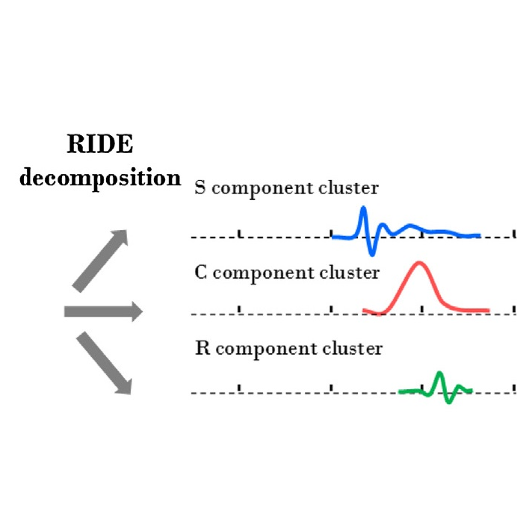
Implement the RIDE algorithm into the Unfold.jl toolbox
Master‘s Thesis Final Talk
Notes:
TODO: Bild austauschen, evtl RIDE graph

Slide 2
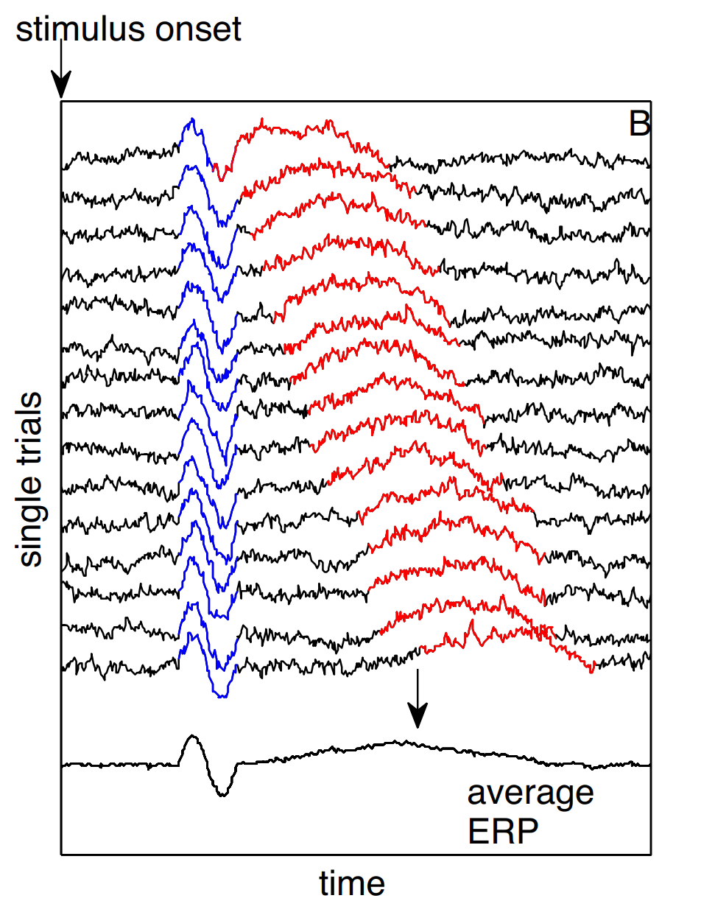
Introduction
Electroencephalogram (EEG) to gather data during an experiment
Event related potentials (ERP) to analyze EEG data and identify components
Problem with time jittered components
“Smearing” on the ERP
Reproduced from [2]
Notes:
Todo Bilder Captions (Quelle)
Explain every figure
Conclusions are optional

Slide 3
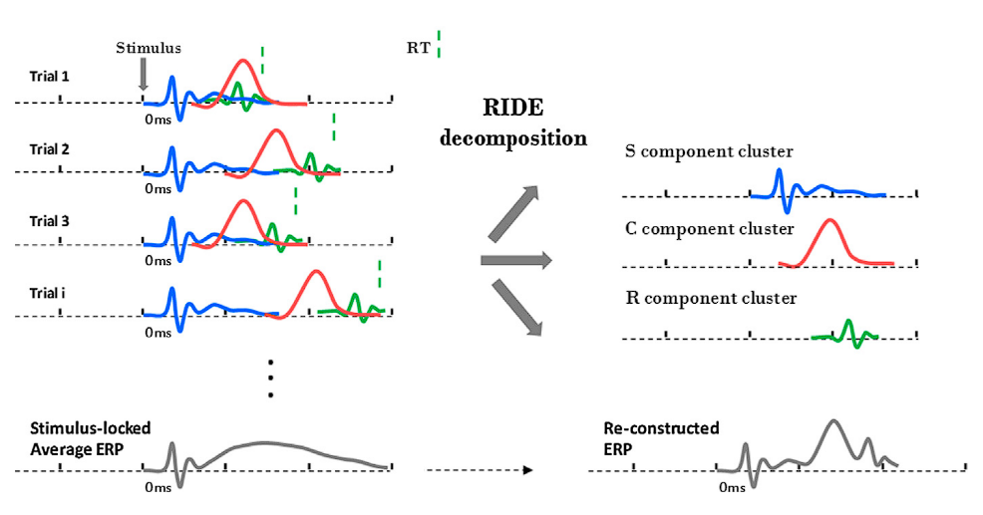
RIDE (Residue Iteration Decomposition)
Developed by Ouyang et al. [1, 2]
First published in 2011
Analyzing EEGs
ERP component decomposition
Time jittered components
Three different component clusters
S: locked to stimulus onset
R: locked to response time
C: related to stimulus onset, but with variable latency
Reproduced from [2]
Notes:
Mention that ride is a bit old (2011)

Slide 4
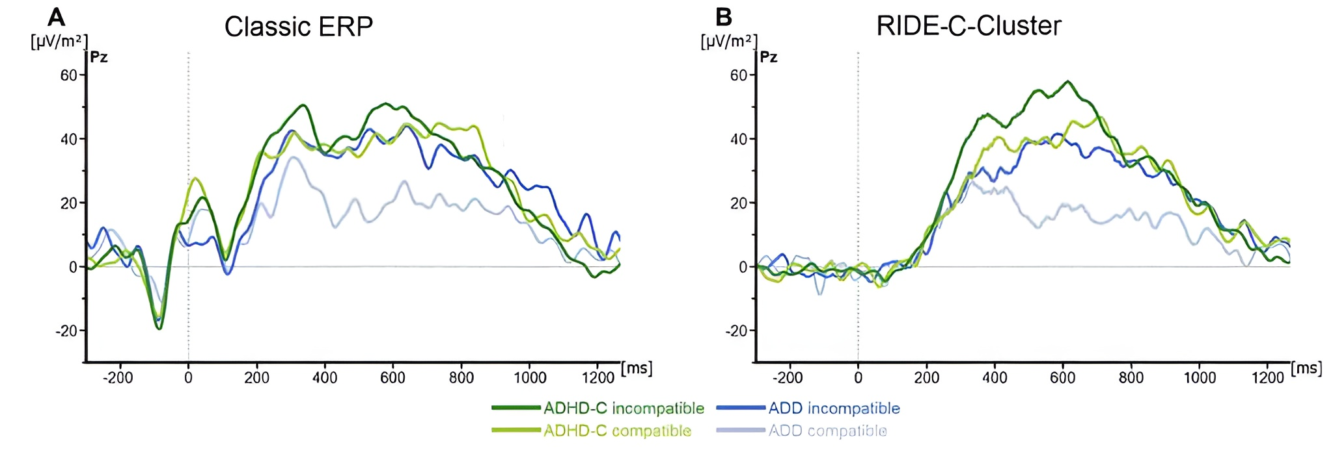
RIDE (Residue Iteration Decomposition)
Found use in multiple Studies
Comparing ADD and ADHD Patients in a Flanker task (2017) [3]
Mapping the brain through event codes (2018) [4]
Notes:
Bilder von Studien in denen RIDE verwendet wurde
Kurz halten. Eigene Folie nur um Content Überschaulich zu halten.

Slide 5
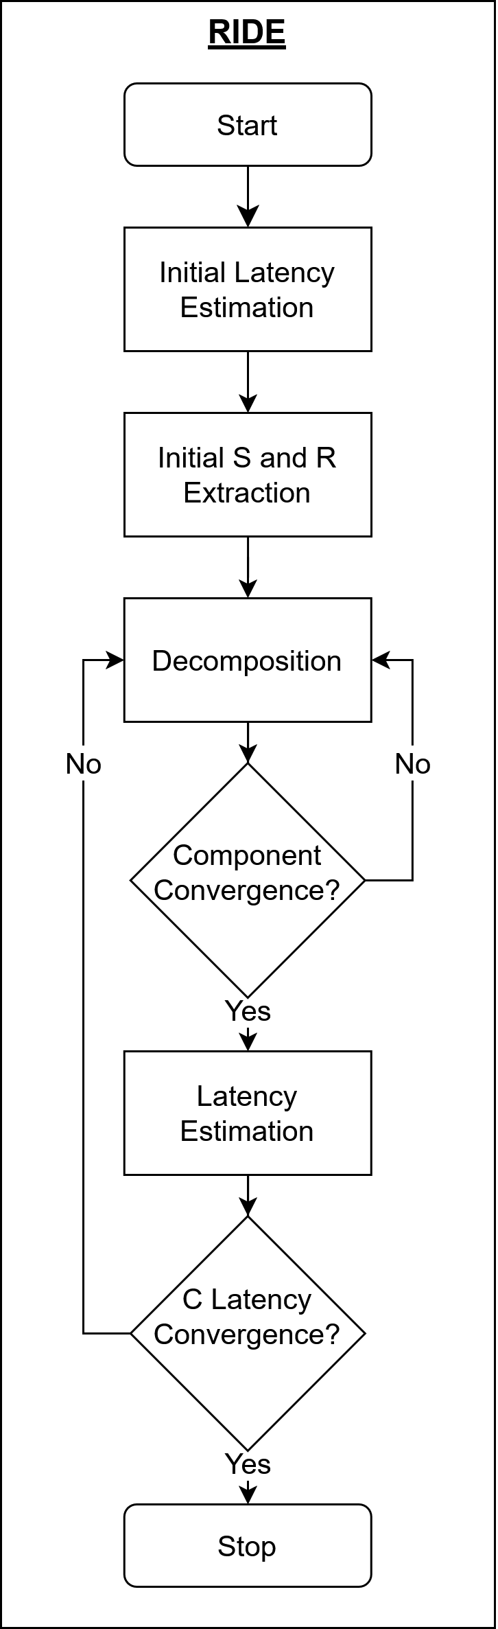
RIDE Decomposition
Notes:
TODO: Overlap correction
Shorten this. Only include unfold and unfoldsim

Slide 6
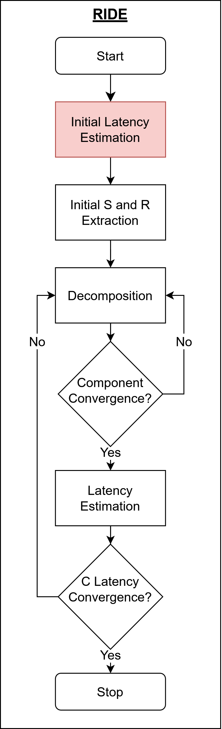
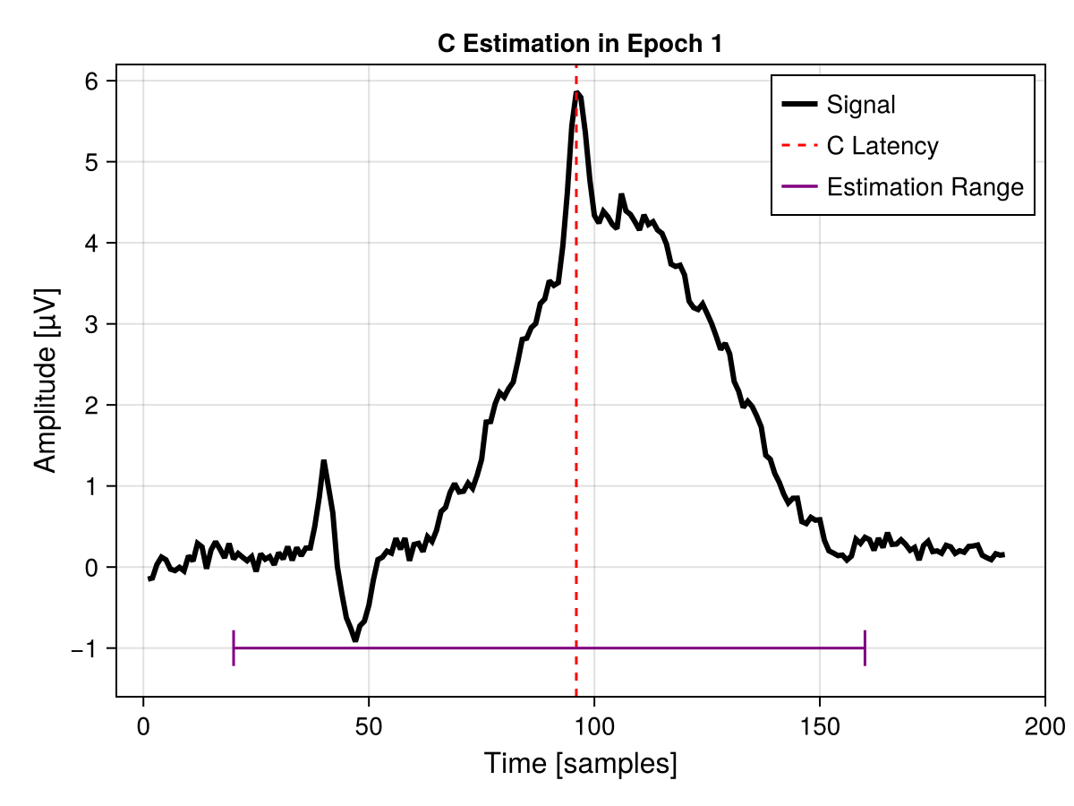
RIDE Decomposition
Notes:
Just peak picking for initial latency
Original matlab implementation used woodys adaptive filter

Slide 7
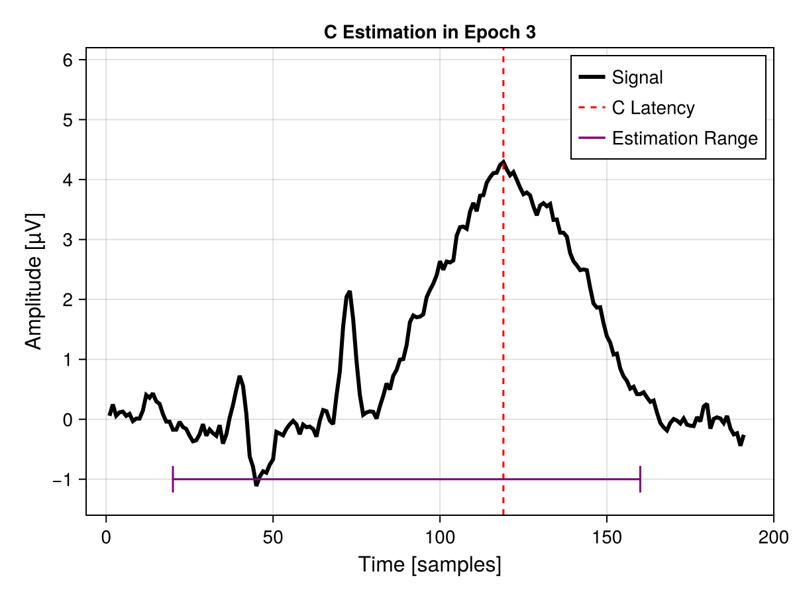
RIDE Decomposition
Notes:
TODO: Overlap correction
Shorten this. Only include unfold and unfoldsim

Slide 8
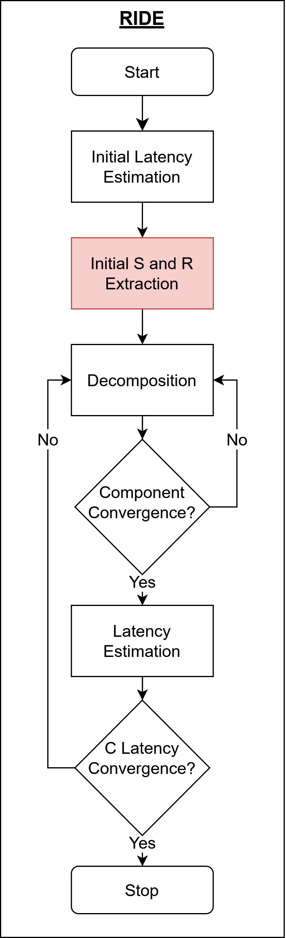
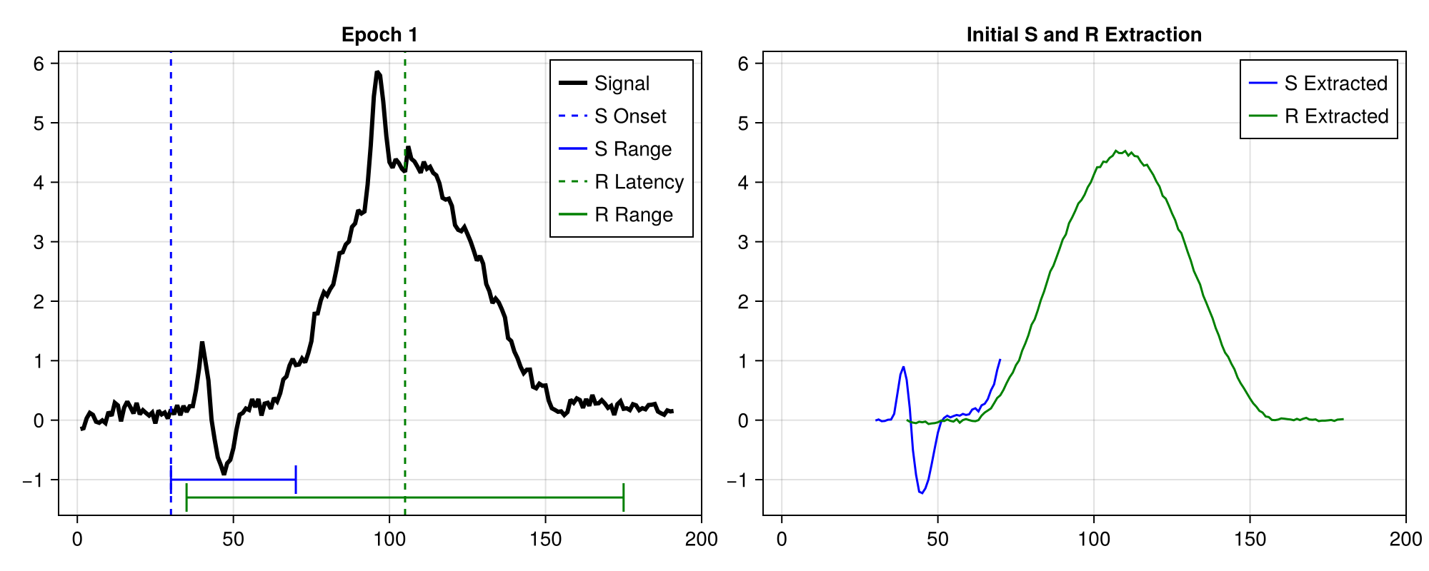
RIDE Decomposition
Notes:
TODO: Overlap correction
Shorten this. Only include unfold and unfoldsim

Slide 9
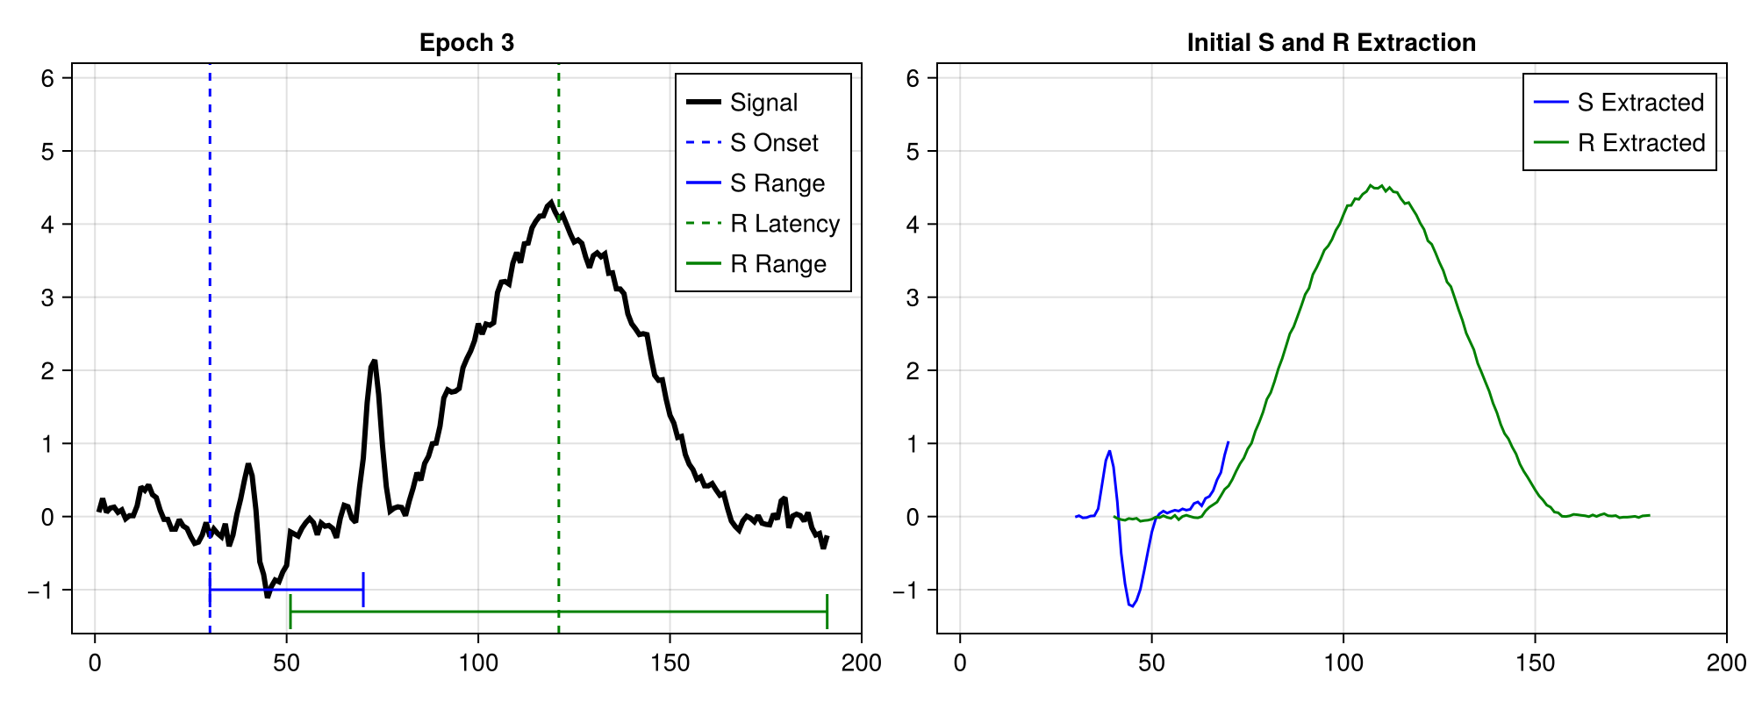
RIDE Decomposition
Notes:
For the decomposition, we need an initial S and R. These don‘t have to be perfect.

Slide 10
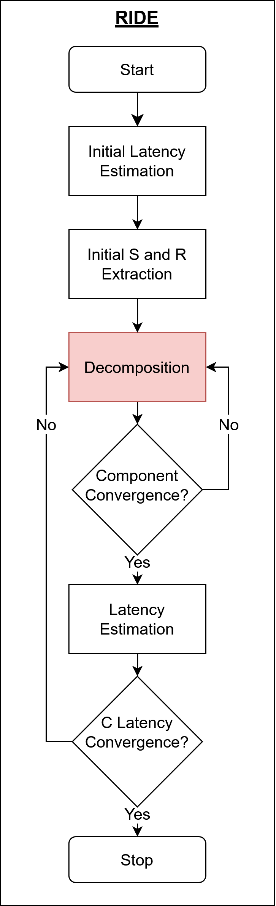
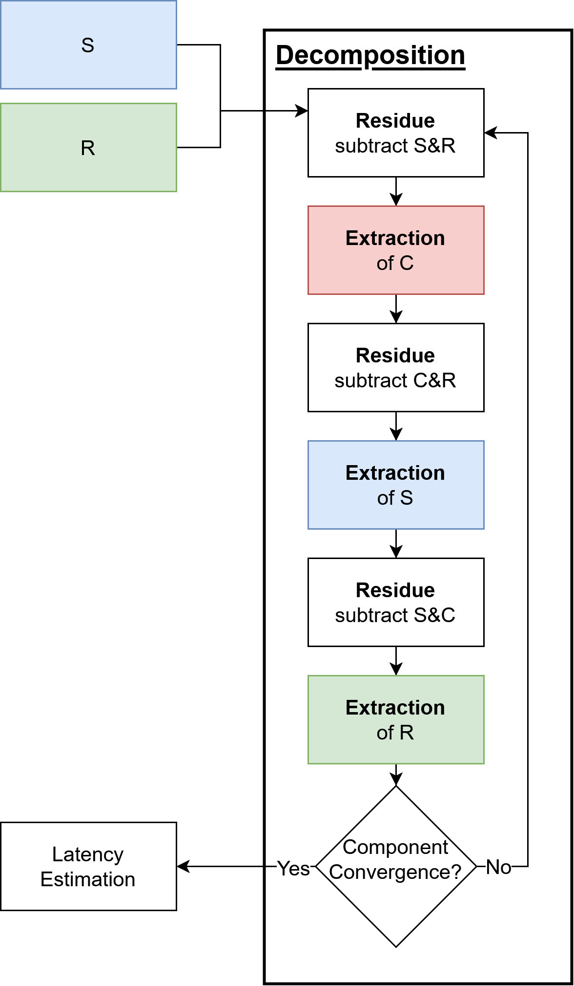
RIDE Decomposition
Notes:
TODO: Overlap correction
Shorten this. Only include unfold and unfoldsim

Slide 11
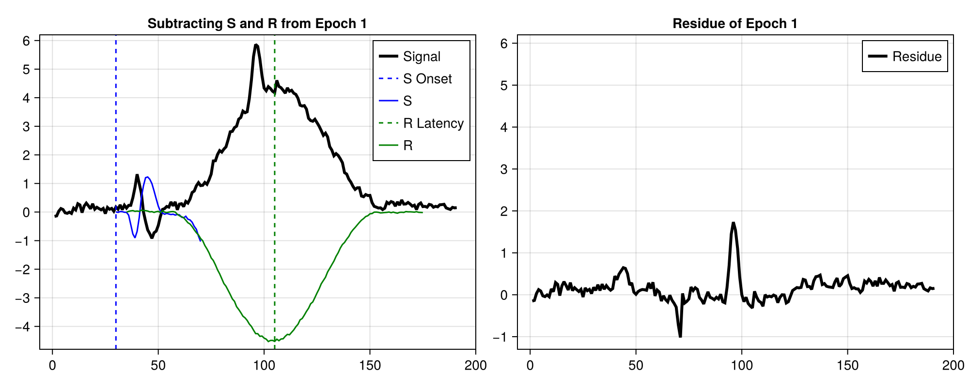
RIDE Decomposition
Notes:
TODO: Overlap correction
Shorten this. Only include unfold and unfoldsim

Slide 12
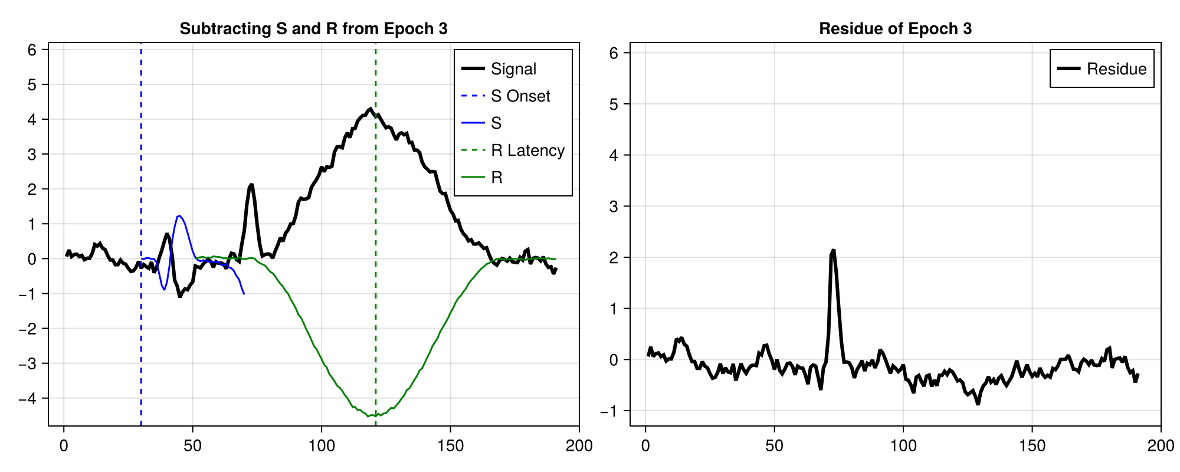
RIDE Decomposition
Notes:
TODO: Overlap correction
Shorten this. Only include unfold and unfoldsim

Slide 13
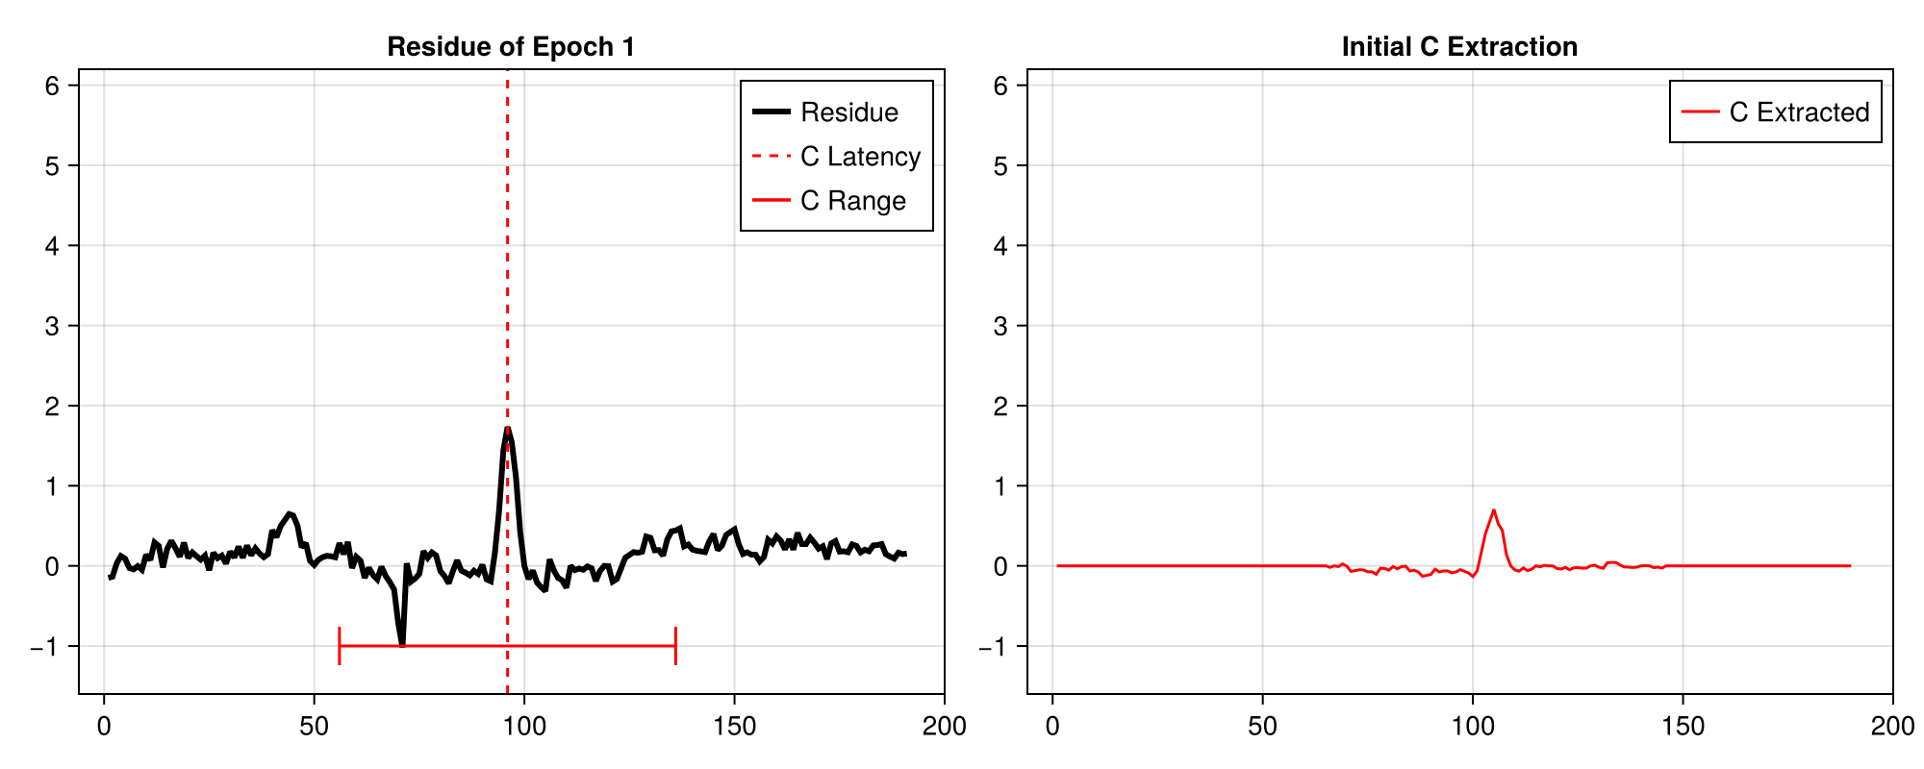
RIDE Decomposition
Notes:
TODO: Overlap correction
Shorten this. Only include unfold and unfoldsim

Slide 14
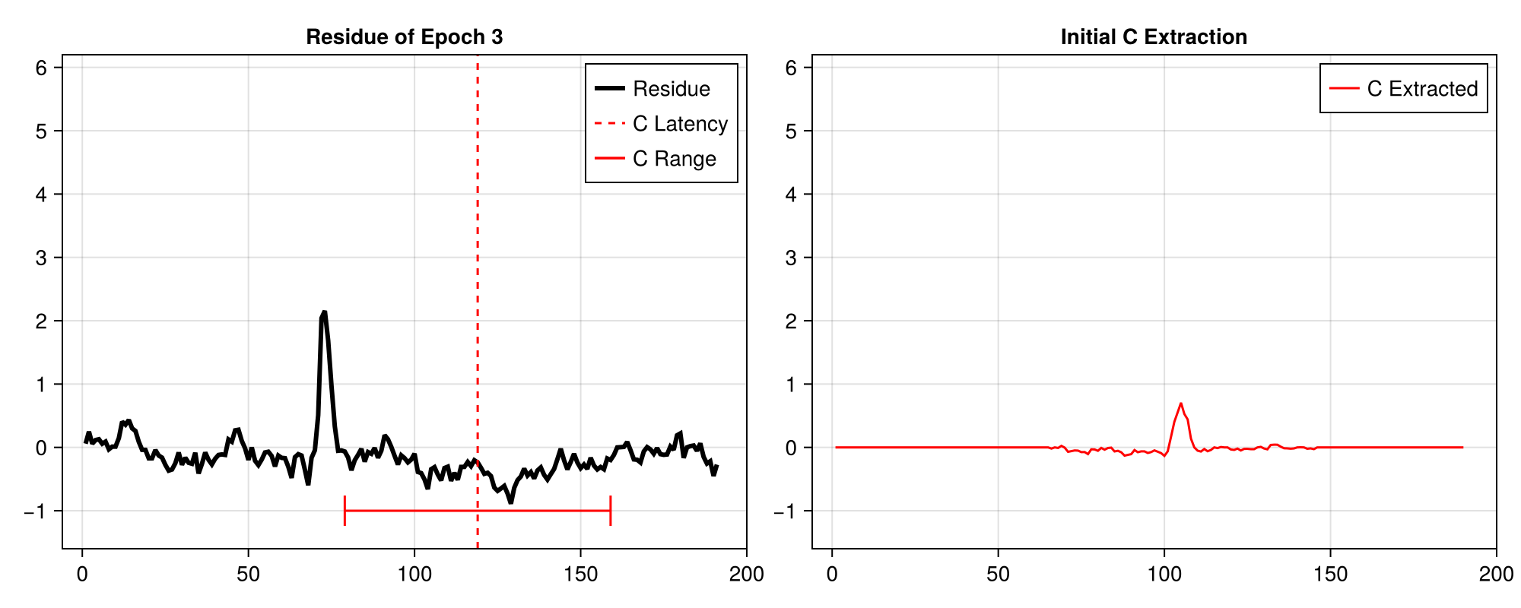
RIDE Decomposition
Notes:
TODO: Overlap correction
Shorten this. Only include unfold and unfoldsim

Slide 15
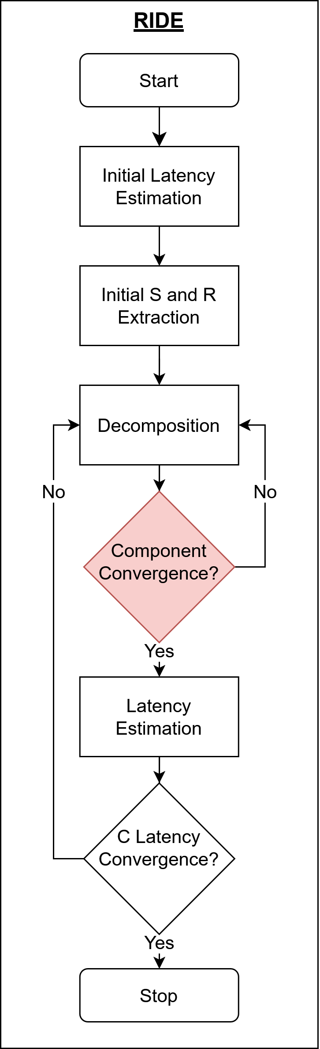
RIDE Decomposition
Notes:
TODO: Overlap correction
Shorten this. Only include unfold and unfoldsim

Slide 16
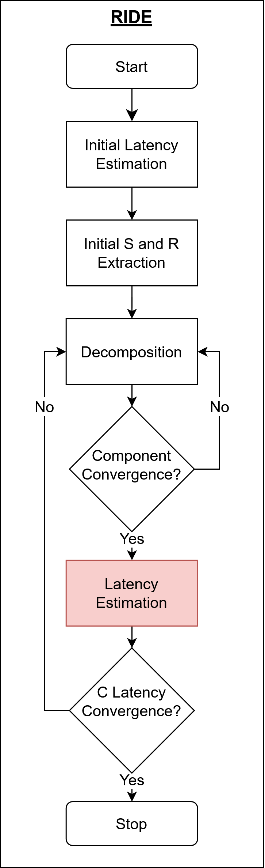
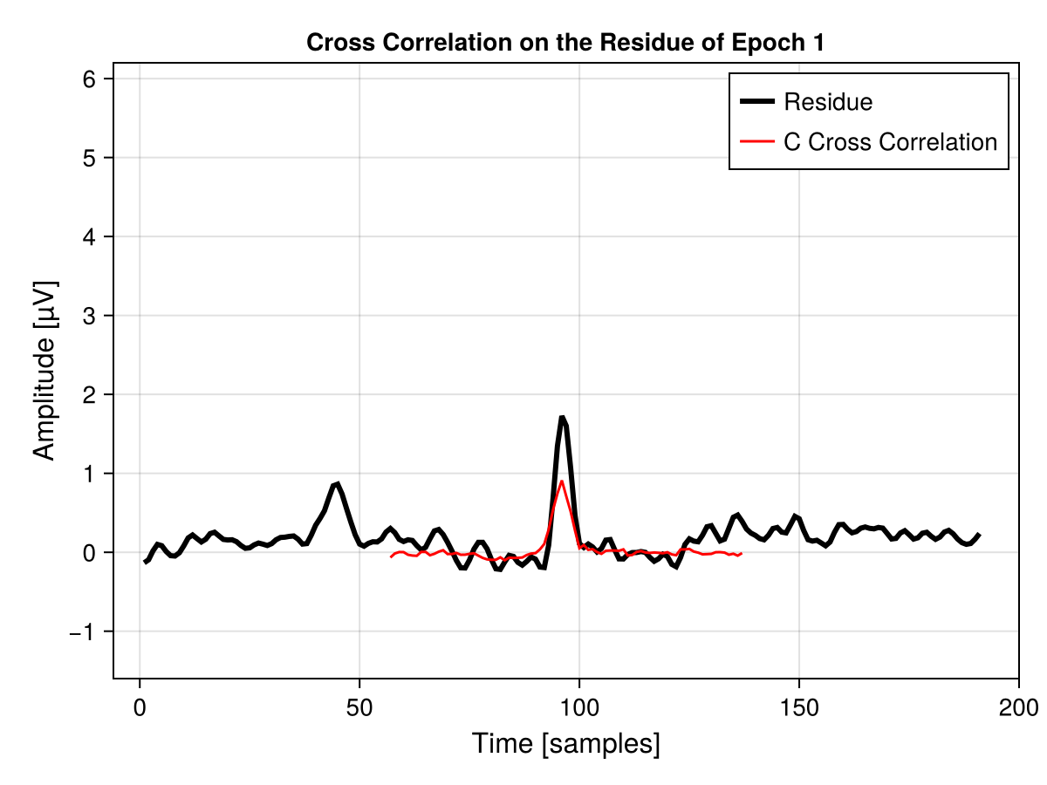
RIDE Decomposition
Notes:
TODO: Overlap correction
Shorten this. Only include unfold and unfoldsim

Slide 17
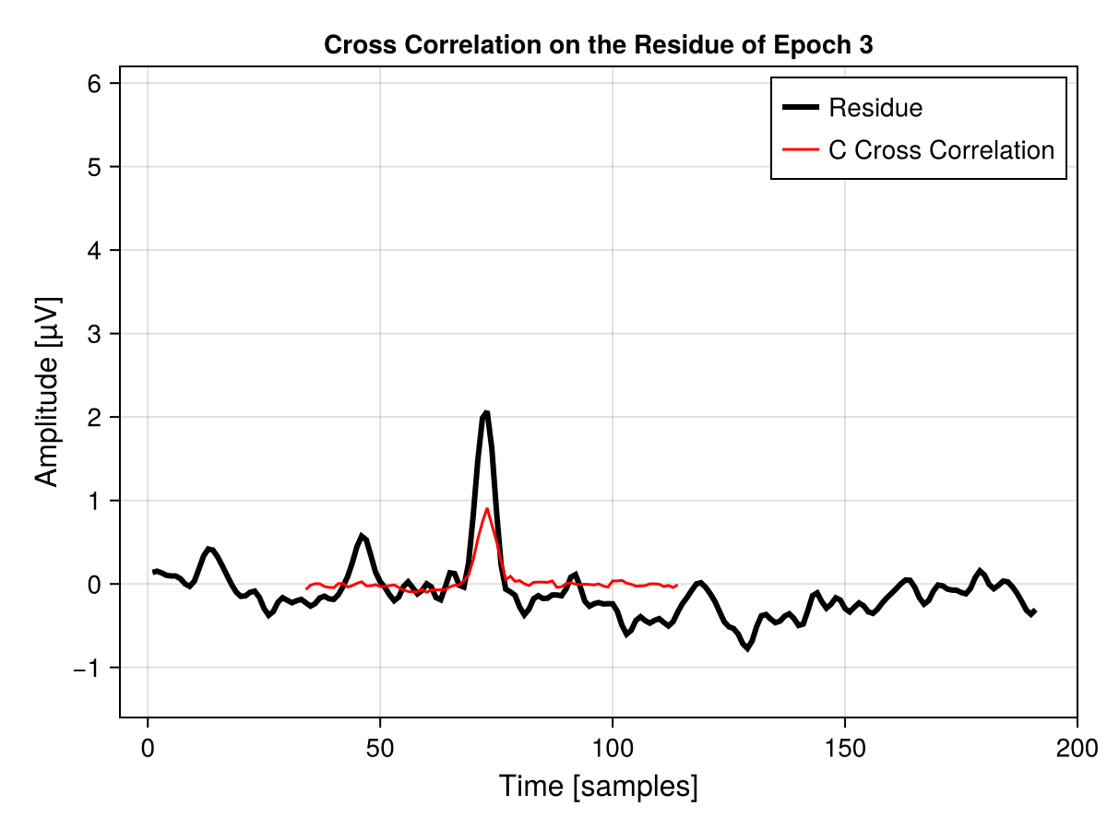
RIDE Decomposition
Notes:
TODO: Overlap correction
Shorten this. Only include unfold and unfoldsim

Slide 18
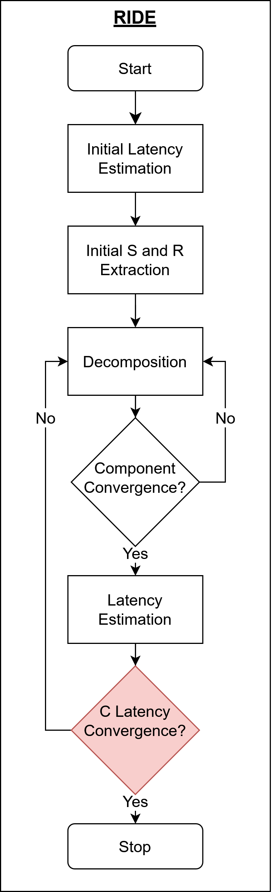
RIDE Decomposition
Notes:
TODO: Overlap correction
Shorten this. Only include unfold and unfoldsim

Slide 19

Unfold
Unfold [5]
Julia toolbox for rERP analysis
Benefits of RIDE
Time jittered components
Benefits of UNFOLD
One step overlap correction
Easy inclusion of Covariates
In active development (last commit 4 days ago 22.03.25)
Notes:
Focus on how RIDE enhances unfold (time jittered components)
Why does it make sense to replace the decomposition with Unfold deconvolution
- Overlapping epochs
- covariants
Mention why we do this project (Motivation)
to combine the benefits of RIDE and Unfold

Slide 20

UnfoldRIDE Implementation
Original Intention was to translate matlab RIDE
Scrapped due to poor code quality
Reimplementation of RIDE as an Unfold Module
ClassicRIDE – reproducing RIDE in Julia
UnfoldRIDE – using Unfold deconvolution
Implementation of additional features
Heuristcs
Filtering
Notes:
Ablauf der Implementation, Struggles

Slide 21
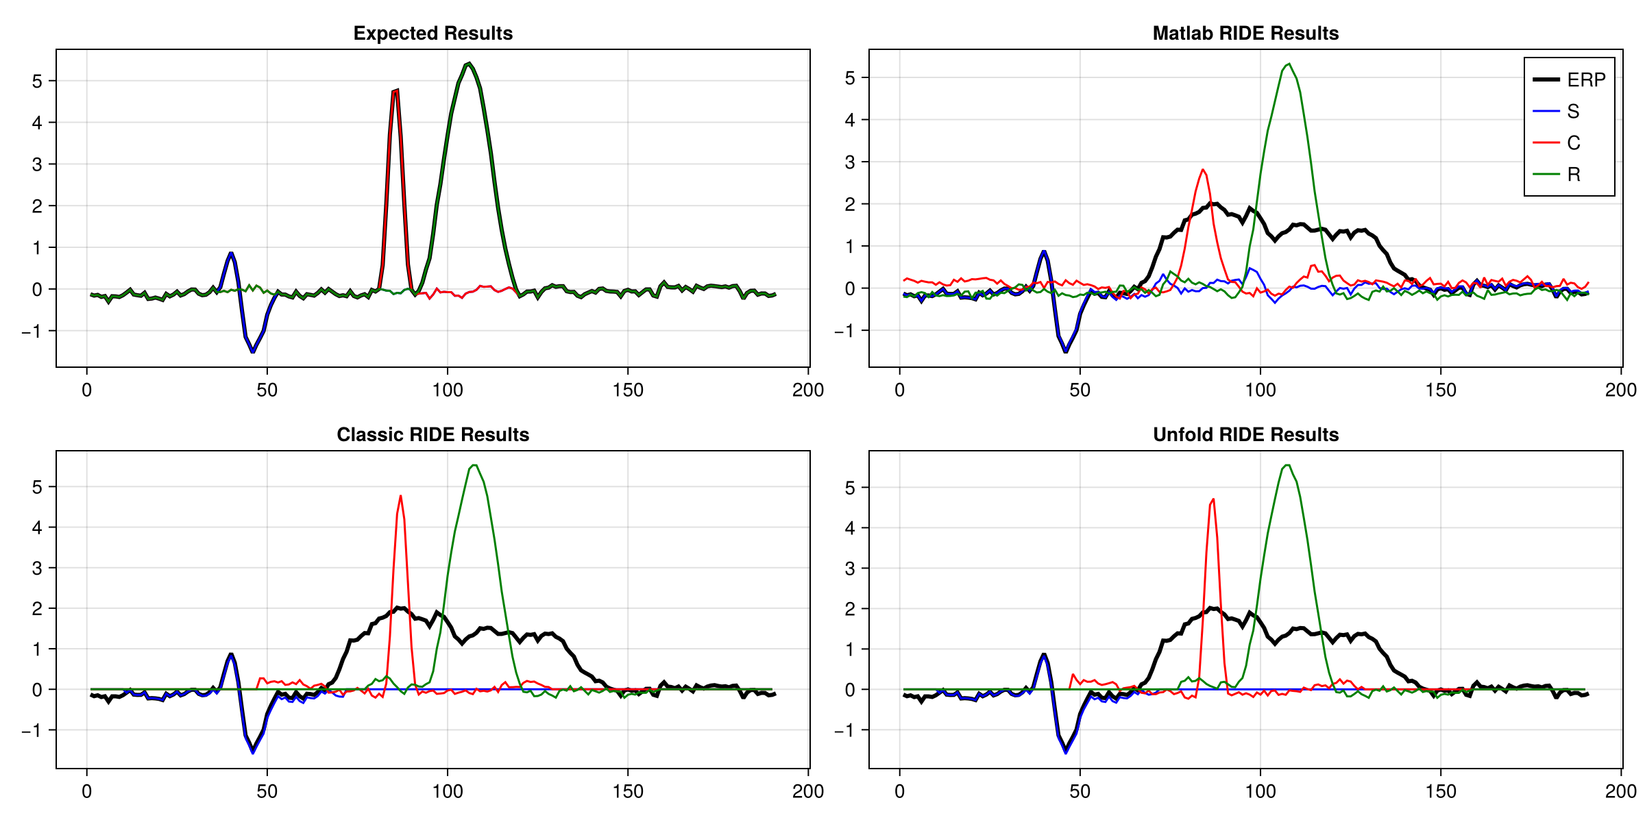
Simulated Results
Notes:
Better Results for Unfold Classic in simulated results. Maybe not representative, since simulated data is too simple.

Slide 22
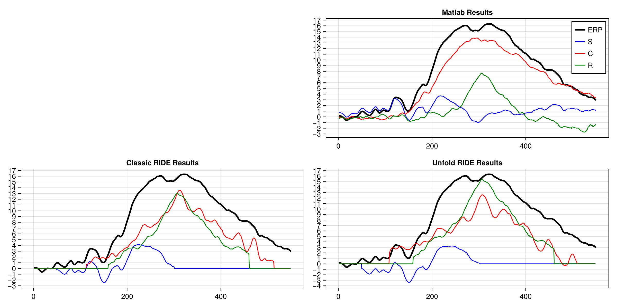
Real Results
Notes:
Clear differences between ride and unfold
Maybe just mention the issue that could be causing this.

Slide 23
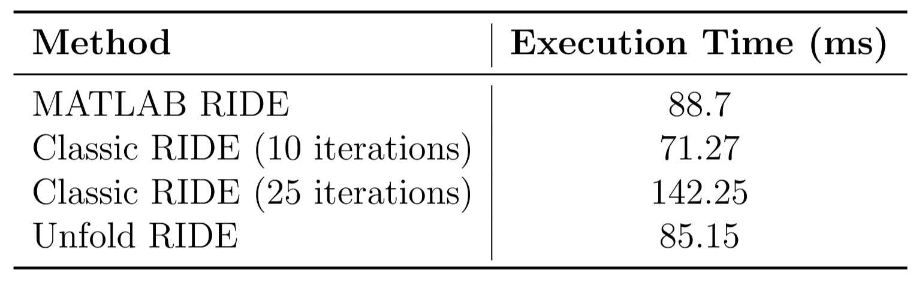
Performance
Single Channel on Simulated Data
Multi Channel on Real Data
UnfoldRIDE: 186,119 s
MatlabRIDE: 35,634 s

Slide 24
Discussion
Limitations
Unexplained Differences between matlab and classic
Lack of performance optimization
Future Work:
Expand data simulation and evaluation
Evaluate on additional real world datasets
Find a better solution for multi channel C latencies
Notes:
Todo double check matlab implementation c_latency mean, checked=yes

Slide 25
Sources
Ouyang, Guang, Grit Herzmann, Changsong Zhou, and Werner Sommer. "Residue iteration decomposition (RIDE): A new method to separate ERP components on the basis of latency variability in single trials." Psychophysiology 48, no. 12 (2011): 1631-1647.
Ouyang, Guang, Werner Sommer, and Changsong Zhou. "A toolbox for residue iteration decomposition (RIDE)—A method for the decomposition, reconstruction, and single trial analysis of event related potentials." Journal of neuroscience methods 250 (2015): 7-21.
Annet Bluschke et al. “Neuronal Intra-Individual Vari-ability Masks Response Selection Differences betweenADHD Subtypes—A Need to Change Perspectives”. In:Frontiers in Human Neuroscience 11 (June 28, 2017).Publisher: Frontiers. ISSN: 1662-5161. DOI: 10.3389/fnhum.2017.00329. URL: https://www.frontiersin.org/journals/human- neuroscience/articles/10.3389/fnhum.2017.00329/full (visited on 08/27/2024).
Witold X. Chmielewski, Moritz M¨uckschel, andChristian Beste. “Response selection codes in neuro-physiological data predict conjoint effects of controlledand automatic processes during response inhibition”.In: Human Brain Mapping 39.4 (2018). eprint:https://onlinelibrary.wiley.com/doi/pdf/10.1002/hbm.23974,pp. 1839–1849. ISSN: 1097-0193. DOI: 10.1002/hbm.23974. URL: https://onlinelibrary.wiley.com/doi/abs/10.1002/hbm.23974 (visited on 08/27/2024).
Benedikt V. Ehinger and Olaf Dimigen. “Unfold: an in-tegrated toolbox for overlap correction, non-linear mod-eling, and regression-based EEG analysis”. In: PeerJ7 (Oct. 24, 2019). Publisher: PeerJ Inc., e7838. ISSN:2167-8359. DOI: 10.7717/peerj.7838. URL: https://peerj.com/articles/7838 (visited on 08/27/2024).
Anna L Gert et al. “WildLab: A naturalistic free viewingexperiment reveals previously unknown EEG signaturesof face processing”. In: European Journal of Neuro-science (Sept. 16, 2022). MAG ID: 4296164644. DOI:10.1111/ejn.15824.
Yan Yan, Laurence T. Hunt, and Cameron D. Has-sall. “Reward positivity biases interval production in acontinuous timing task”. In: (July 7, 2023). MAG ID:4383499942. DOI: 10.1101/2023.07.06.548049.
Joshua Snell et al. “Parallel word reading revealed byfixation-related brain potentials”. In: 162 (May 1, 2023).MAG ID: 4322124135, pp. 1–11. DOI: 10.1016/j.cortex.2023.02.004.
Catherine Manning et al. “Visual Motion and Decision-Making in Dyslexia: Reduced Accumulation of Sen-sory Evidence and Related Neural Dynamics.” In: TheJournal of Neuroscience 42.1 (Jan. 5, 2022). MAG ID:4226134057, pp. 121–134. DOI: 10 . 1523 / jneurosci .1232-21.2021.
Conclusion

Slide 26
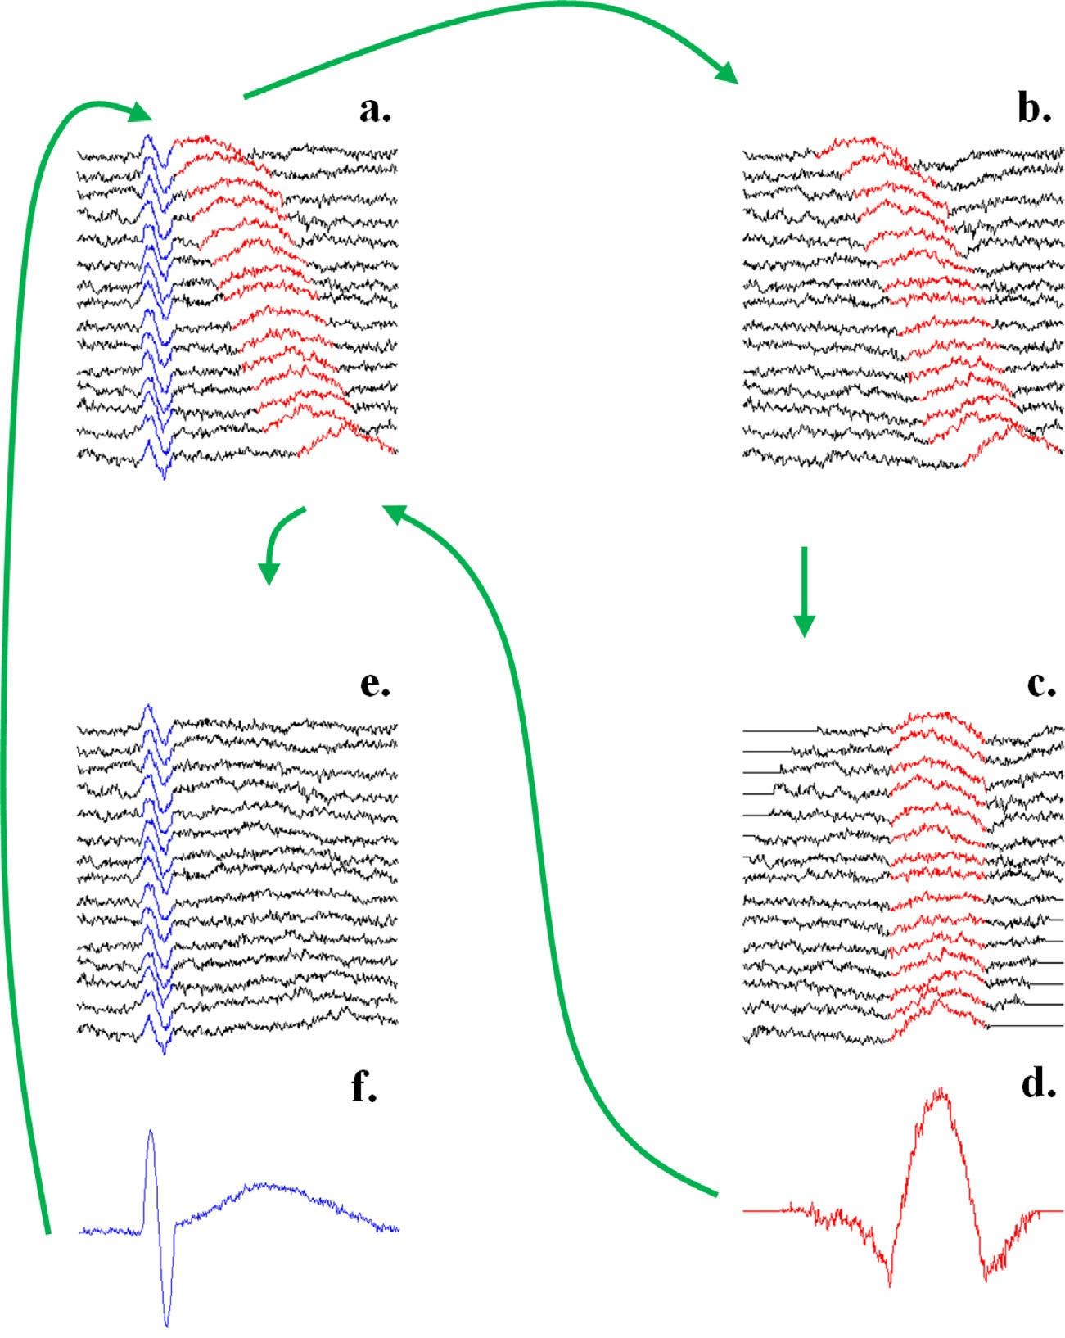
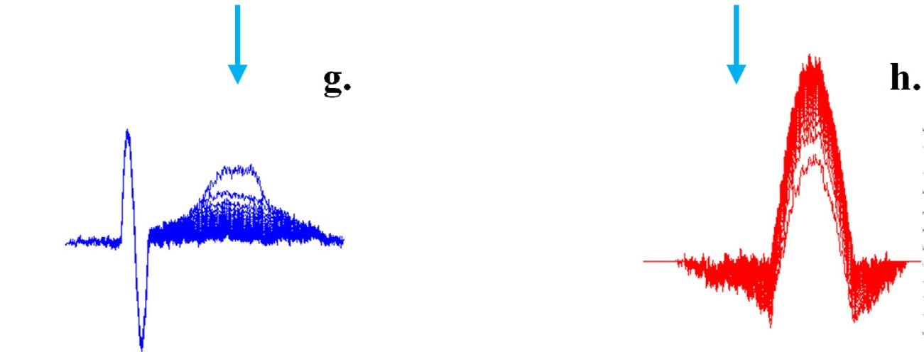
RIDE (Residue Iteration Decomposition)
“Fig. 2. Illustration of the decomposition module using two artificial sinusoidal components, S (blue) and R (red), for a single electrode. (a) Single trial ERPs from different trials with superimposed S, R, and noise. (b) Subtract S from single trials ERP (initially S is stimulus-locked ERP). (c) Align the residue according to the latency of R. (d) Obtain R as the median waveform from (c), for the first time. (e) Subtract R (obtained from (d)) from the single trials ERP. (f) Obtain S again as the median waveform of the residue in e. The route goes to (b) (where the new estimate of S is subtracted from the original single trials) and iterates. (g) and (h) For each iteration, the S and R components obtained from (f) and (d) move closer to the originally given (sinusoidal) waveforms and converge. Note that the plots in (d), (f), (g), and (h) use different scales than (a), (b), (e), and (c). (For interpretation of the references to color in this figure legend, the reader is referred to the web version of this article.)”
Adapted from [2]
Conclusion

